Slide 1
Corpus Linguistics
2023-11-10
Levels of Linguistic Representation

Slide 2
From last class
Sample & Population
Skewing & Balance
Parameters of a corpus
Representativeness, Spontaneity, Routinization, Saturation
Variants, lexical vs. external conditioning
Lexical semantics
Synonyms and meaning clusters
Review of concepts from phonology / phonetics

Slide 3
This class
Phonetics
Morphology
Syntax
Discourse

Slide 4
Praat
website: https://www.fon.hum.uva.nl/praat/download_win.html

Slide 5
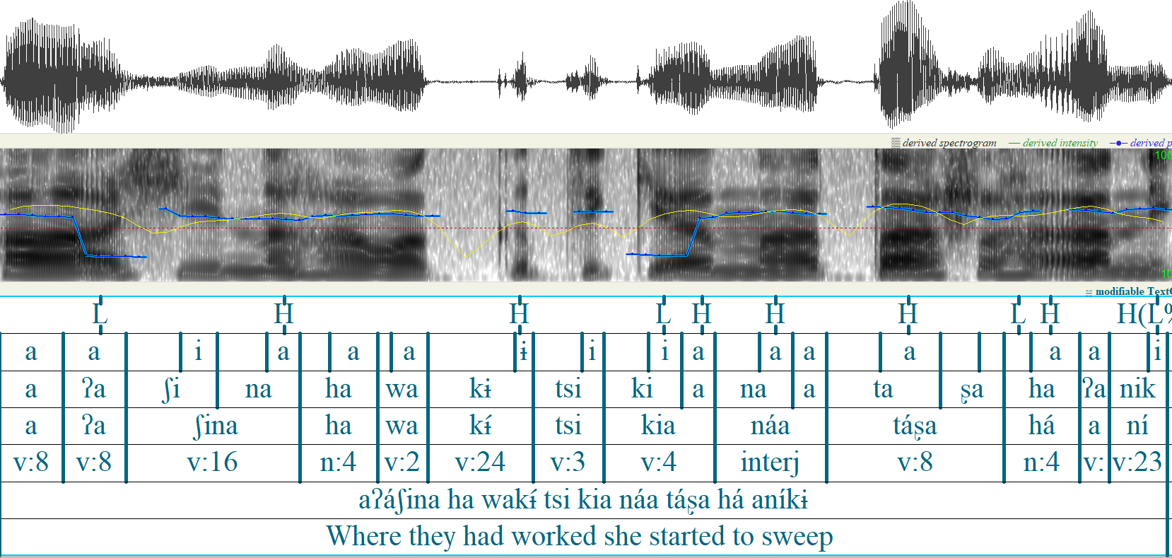
This is a Praat annotation of a sentence in Chácobo, a southern Pano language of the northern Bolivian Amazon.

Slide 6
Waveform
Spectrogram
Tiers
This is a Praat annotation of a sentence in Chácobo, a southern Pano language of the northern Bolivian Amazon.

Slide 7
Phonetic measurements
Phones have different phonetic measurements associated with them.
A consonant has
Duration (milliseconds)
Voice onset and offset time (milliseconds)
Voicing (milliseconds or amplitude
Vowel
Duration (milliseconds)
Pitch (F0)
Intensity (amplitude)

Slide 8
Phonetic measurements
F1 and F2
Vowels have an F1 and an F2
These are the main measurements of vowel quality.
F1: Vowel height (low F1 means high)
F2: Vowel frontness (high F2 means front)

Slide 9
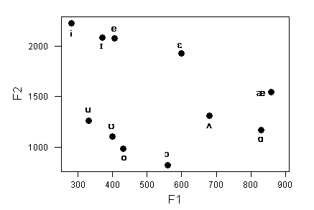

Slide 10
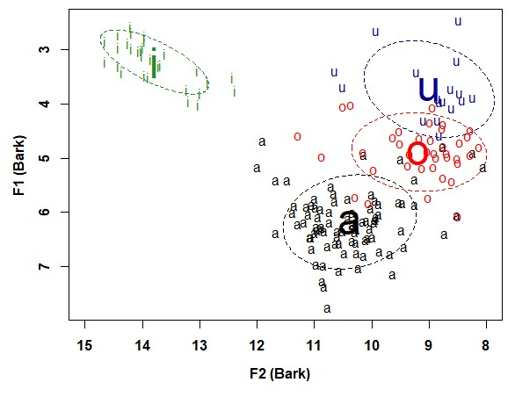
Phonetic measurements
Actual vowel tokens are much more variable
https://fass.ubd.edu.bn/research/dusun/vowels3.html

Slide 11
Phonetic measurements
How does one develop a phonetic annotation? (e.g. know the boundaries between different sounds)
There are acoustic ‘landmarks’ that can be used to segment speech into phones.
But
Developing a phonetic corpus by hand is very time consuming – which is why people use forced alignment systems.

Slide 12
Morphology
Morphemes
Allomorphy
Compositionality
Productivity
realized, expanded, potential
Segmentability
Morphology and phonetic reduction
Borrowing

Slide 13
Morphology
Morphology is concerned with word internal structure (generally)
A central concept is the morpheme
Words are made up of morphemes – morphemes are the smallest meaningful parts of words.
complete-ness has two morphemes

Slide 14
Morphology
Some other core concepts:
Bound: Some morphemes are ‘free’ (they can occur on their own) and others are bound (they depend on the appearance of something else to occur)
Roots: The base of th Word, e.g. (complete in completeness)
Affixes: The bound parts that are modifying the base (-ness in completeness

Slide 15
Morphophonology / Allomorphy
Morphemes have different realizations depending on context
Plural –s is realized as –s or –z or -əz depending on the word
dogs > [dagz]; cat > [kæts]

Slide 16
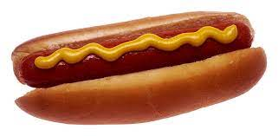
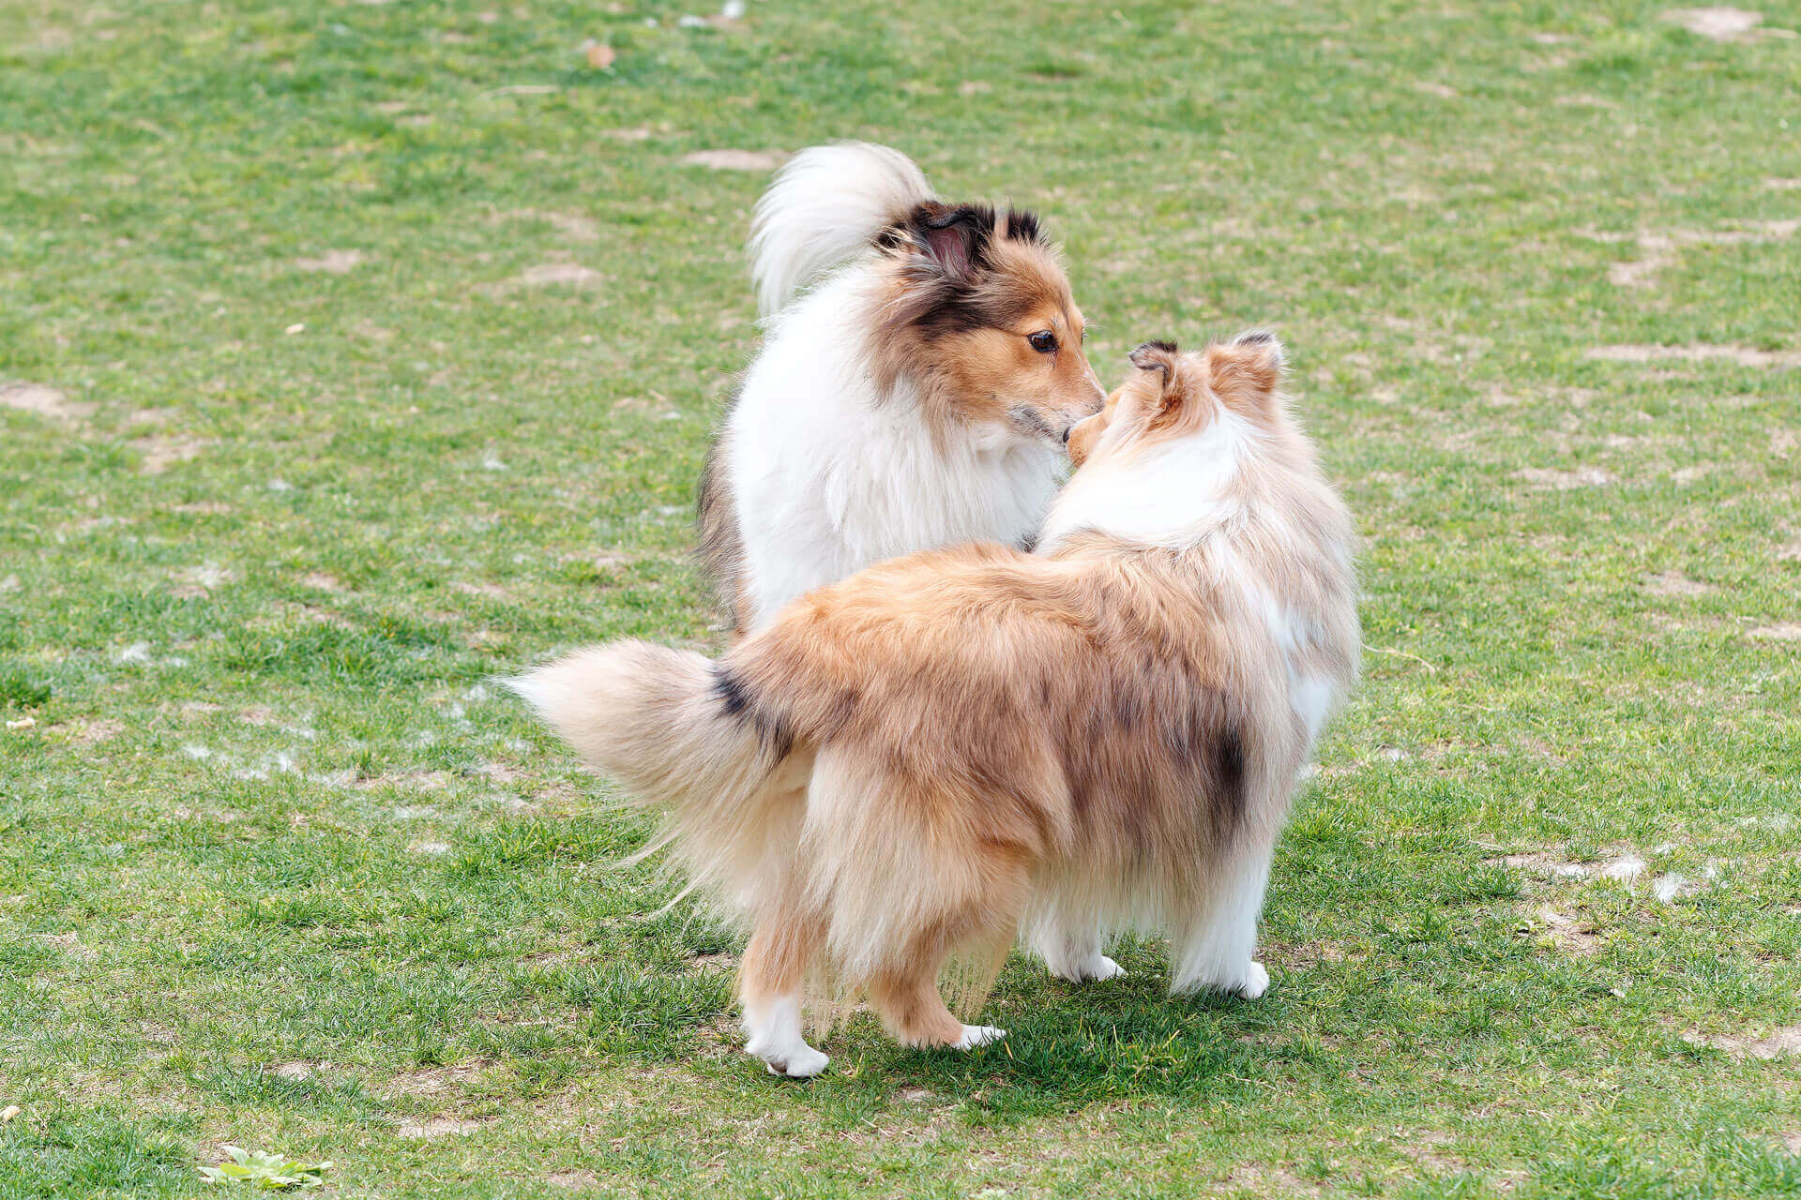
Compositionality
Words vary in terms of how compositional they
How easy it is to discern the meaning of the whole from the parts
hot dog not very compositional

Slide 17
Morphological productivity
Morphemes vary in terms of their productivity.
Some morphemes like –ness are highly productive
Others like –th in warmth only occur with a small number of forms.

Slide 18
Morphological productivity
Realized productivity: high memberships (lots of words have this morpheme)
Expanded productivity: growing memberships (new words use this morpheme)
Potential productivity: we think it could be used with lots of words

Slide 19
Realized productivity

Slide 20
Expanded productivity

Slide 21
Potential productivity

Slide 22
Segmentability

Slide 23
Morphology and phonetic reduction

Slide 24
Borrowing

Slide 25
Syntax

